Slide 1

Machine Learning Foundations
A beginner-friendly guide to understanding concepts before code.
Instructor Notes:

Slide 2






Our Journey Today
1. Preparing the Ingredients
2. Following the Recipe
3. Taste Testing
ML Workflows: The step-by-step process of training a model without accidentally "cheating" on the test.
Model Evaluation: Simple ways to score our model's performance to know if it's actually doing a good job.
Feature Engineering: How to clean, slice, and prep raw data so our ML model can easily digest it.
Instructor Notes:

Slide 3
1. Feature Engineering
Turning messy, real-world data into something a computer can understand.
Instructor Notes:

Slide 4
What is Feature Engineering?
•
The Problem: Computers are very literal. If you give a model a column called "Birthdate: 1990-05-14", it just sees a random string of text and numbers.
•
The Solution: We create a new column called "Age: 34". Now the computer can easily see a pattern!
•
Why it matters: Feature Engineering is simply helping the model connect the dots by giving it better clues.
Instructor Notes:

Slide 5
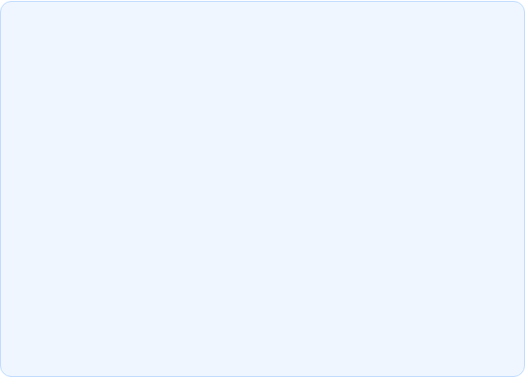
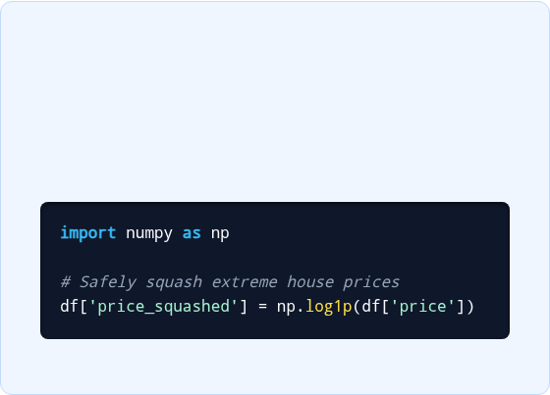
Taming Extreme Values (Log Transformation)
The Problem: "The Billionaire Effect"
The Solution: "Squashing"
Imagine measuring average wealth in a room of 10 people making $50k. If Elon Musk walks in, the "average" wealth becomes $10 Billion.
A Log Transformation acts like a volume knob, turning down extreme values so they don't drown out the normal data.
Extreme outliers confuse machine learning models. They skew the perspective.
Instructor Notes:

Slide 6
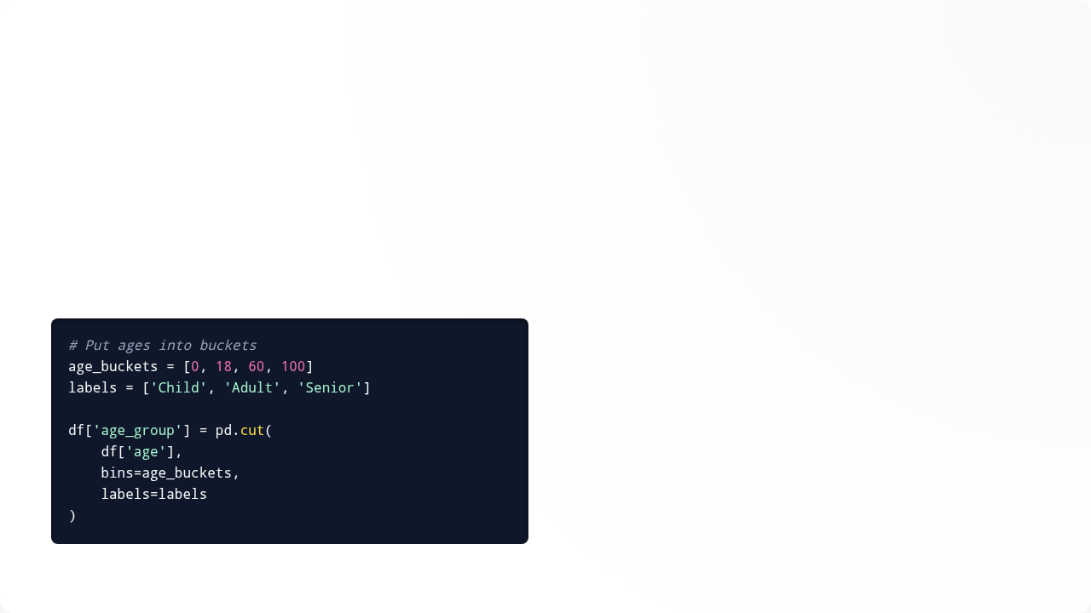
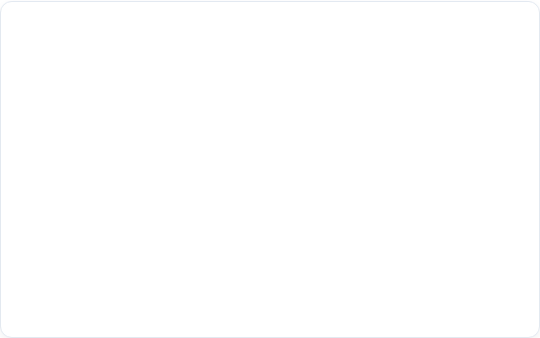
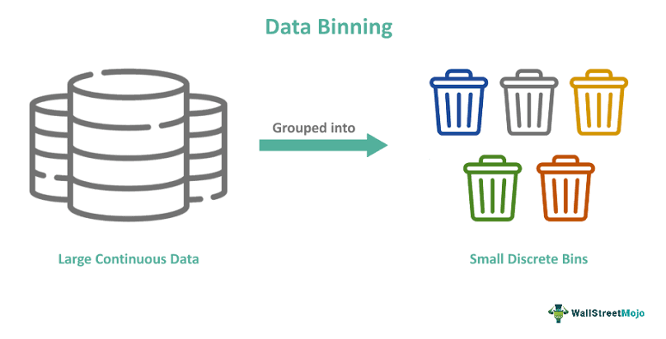
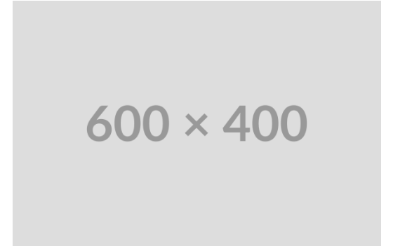
Binning: Sorting into Buckets
•
The Concept: Think of sorting laundry into "Lights", "Darks", and "Colors". You don't need 50 different categories, just a few broad buckets.
•
Why use it? Sometimes exact numbers are too noisy. Is there a big difference between earning $50,001 and $50,002? No. It's better to put them both in an "Average Income" bucket.
Instructor Notes:

Slide 7
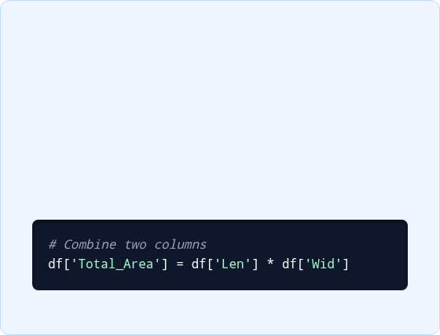
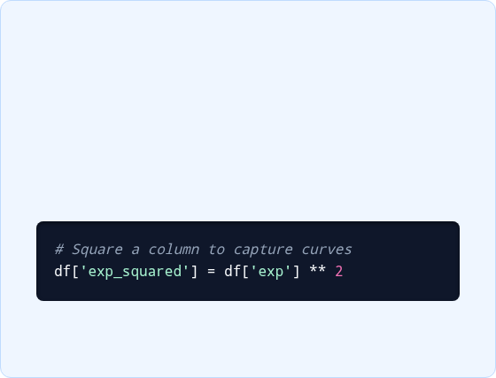
Combining Clues (Interaction Features)
Interaction Features
Polynomial Features
Combining two basic clues to make one super clue.
Handling curves instead of straight lines.
Example: A little experience gets you a small raise. A LOT of experience gets you a massive raise. The impact curves upward (it squares).
Example: Knowing a house's Length and Width is okay. But multiplying them to create Total_Area is a massive help to the model!
Instructor Notes:

Slide 8
Translating Text into Math (Encoding)
Models cannot read words like "Red" or "Small". We must encode text into numbers.
Technique | Analogy | When to use it? | What it looks like
Label Encoding | T-Shirt Sizes: They have a logical order. Medium is bigger than Small. | When categories have a natural ranking (Ordinal). | Small = 1 Medium = 2 Large = 3
One-Hot Encoding | Ice Cream Flavors: Vanilla isn't "greater" than Chocolate. They are just different. | When categories have NO ranking (Nominal). | Is_Vanilla = 1 Is_Chocolate = 0
Instructor Notes:

Slide 9
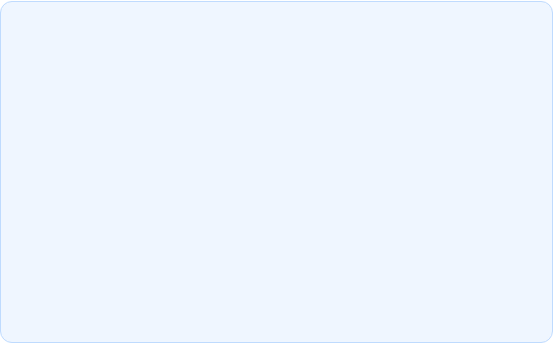
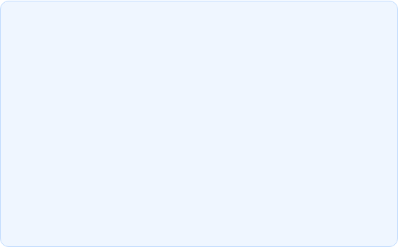
Handling Too Many Categories
Frequency Encoding (Popularity)
Target Encoding (Average Score)
If you have 1,000 different Zip Codes, One-Hot Encoding makes 1,000 new columns! That's too messy.
Replace the category with the average outcome of that group.
Instead of the word "Brooklyn", we replace it with the average house price in Brooklyn: "$800,000". The model loves this!
Instead, replace the Zip Code with how often it appears. (e.g., "ZipCode_123" becomes "500" because 500 people live there).
Instructor Notes:

Slide 10
Summary: Prepping a Housing Dataset
Log Transform: We squashed the multi-million dollar house prices so they didn't ruin our averages.
Interaction Features: We multiplied Width x Length to give the model a Total_Square_Footage clue.
Label Encoding: We changed Kitchen Quality from (Poor, Fair, Good, Excellent) to (1, 2, 3, 4).
One-Hot Encoding: We made separate Yes/No columns for Roof Styles (Is_Flat=1, Is_Gabled=0).
Instructor Notes:

Slide 11
2. Machine Learning Workflow
How to train models properly without cheating on the final exam.
Instructor Notes:

Slide 12
The ML Assembly Line
2. Hide Data
4. Final Test
Hide a portion of the data (The Test Set) so the model can't cheat.
Test the model on the hidden data to see if it actually learned.
1. Get Data
3. Train Model
Load the data and clean up the missing pieces.
Let the algorithm look at the remaining data to learn patterns.
Instructor Notes:

Slide 13
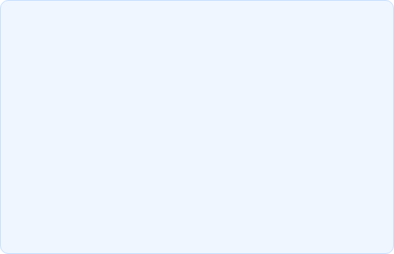
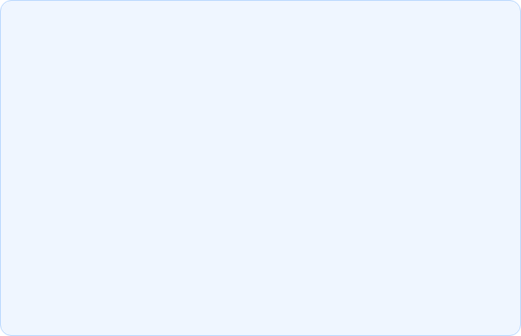
Supervised vs. Unsupervised Learning
Supervised Learning
Unsupervised Learning
Analogy: Studying with flashcards that have the answers on the back.
Analogy: Being handed a giant bucket of mixed Lego blocks and told to "sort them".
The dataset includes the final answers (labels). We teach the model by example.
The dataset has NO answers. The model must find hidden groupings on its own.
Example: Giving a model photos labeled "Cat" or "Dog" so it learns the difference.
Example: Grouping customers into different buying habits without knowing who they are.
Instructor Notes:

Slide 14
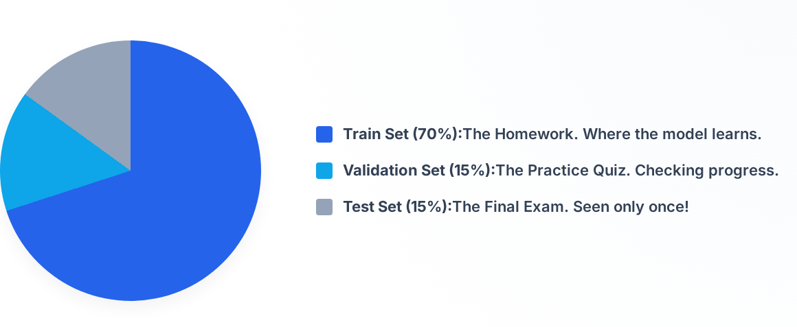
The School Analogy (Splitting Data)
Instructor Notes:

Slide 15
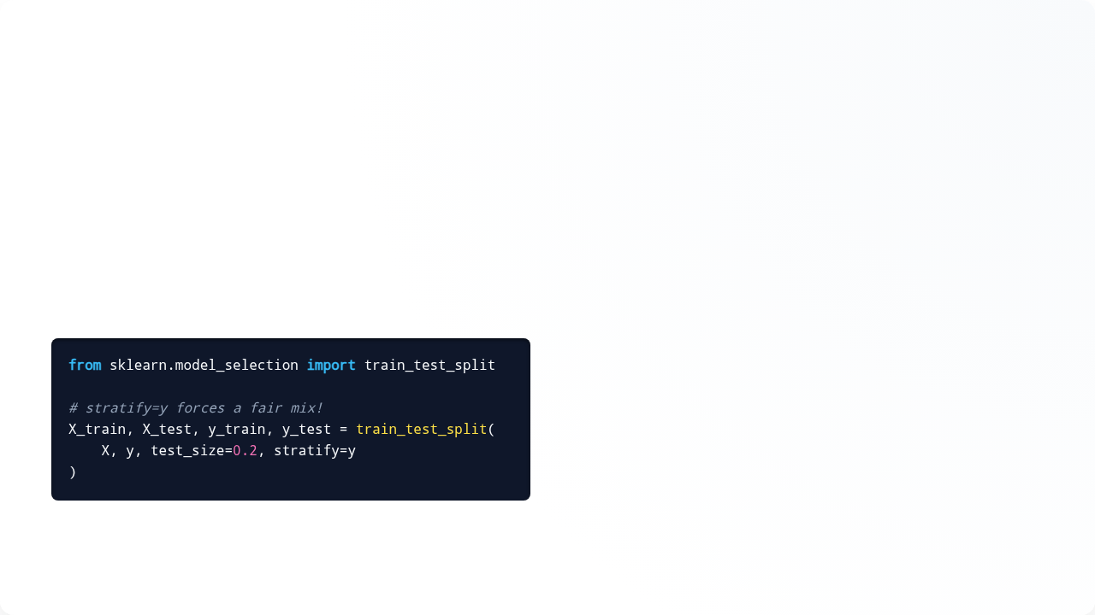
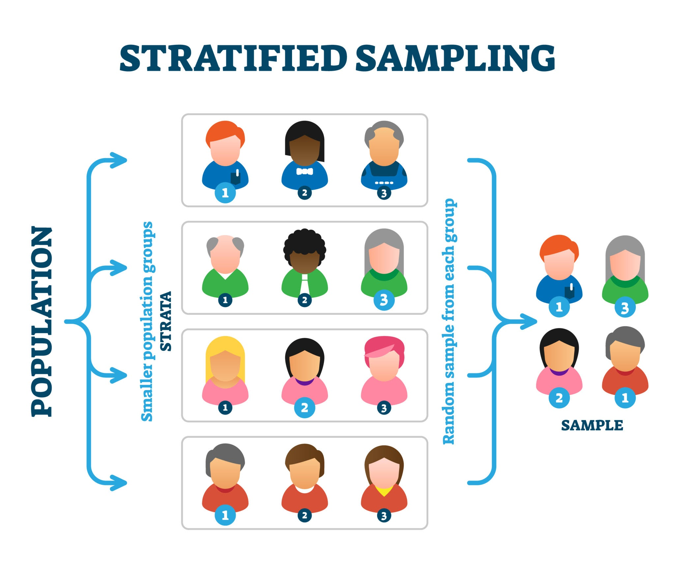

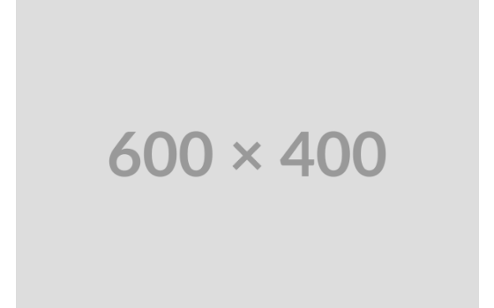
Keeping Things Fair (Stratified Sampling)
•
The Danger: If 90% of emails are normal and 10% are spam, a random split might accidentally put ALL the spam in the Test Set. The model would never see spam during training!
•
The Fix: Stratified Sampling ensures that both your Train and Test sets have the exact same 90/10 mix.
Instructor Notes:

Slide 16

K-Fold Cross Validation
Why rely on just ONE lucky test?
Imagine taking 5 different versions of a Final Exam.
In K-Fold, we chop our data into 5 equal pieces. We train the model 5 separate times, rotating which piece acts as the final exam.
Result: We average all 5 test scores to get a much more trustworthy grade!
Instructor Notes:

Slide 17
Stratified K-Fold
Combining the Best of Both Worlds
As you might guess, Stratified K-Fold just applies the "fair mix" rule to all 5 versions of the exam.
It guarantees that every single fold maintains the correct percentage of each class (e.g., 90% normal, 10% spam). This is the gold standard for testing.
Instructor Notes:

Slide 18
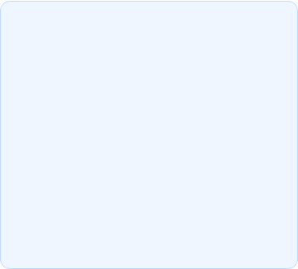
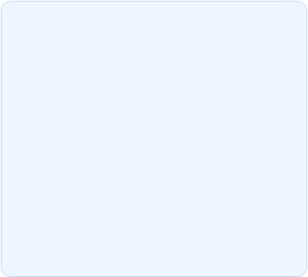
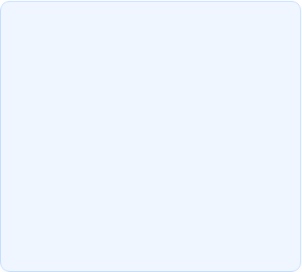



The Silent Killer: Data Leakage
What is it?
The Symptom
The Cure
Sneaking the answer key into the exam room. The model accidentally "sees the future" during training.
Your model gets 99.9% accuracy on your laptop, but completely fails when you use it in the real world.
ALWAYS separate your Train and Test sets before you do any feature engineering or data cleaning.
Instructor Notes:

Slide 19
Simple Rules to Remember
Split Early: Cut out your Test Set on step 1 and lock it in a vault. Don't touch it until the very end.
Fit on Train, Transform on Test: If you calculate the average age to fill in missing data, ONLY calculate the average of the Train Set. Use that same number to fill the Test Set.
Set Random Seeds: Always write `random_state=42` in your code so that if you run the script tomorrow, it splits the data the exact same way.
Instructor Notes:

Slide 20
3. Model Evaluation
How do we know if our model is actually good?
Instructor Notes:

Slide 21






Beyond Simple Accuracy
Accuracy
Precision (The Cautious Guesser)
Recall (The Over-Achiever)
Total Correct / Total Guesses. Good for balanced data. Bad if 99% of the data is the same category.
"When I call an email SPAM, I want to be 100% sure." Minimizes False Alarms.
"I want to catch EVERY SPAM email, even if I accidentally grab some normal ones." Minimizes Missed Threats.
Instructor Notes:

Slide 22
The Confusion Matrix (Medical Test Analogy)
A table that shows exactly how your model is messing up. Let's imagine predicting if someone has a cold.
 | Model says: SICK (Positive) | Model says: HEALTHY (Negative)
Patient is actually: SICK | True Positive (TP) Correct Diagnosis! | False Negative (FN) Oh no, the model missed it!
Patient is actually: HEALTHY | False Positive (FP) False Alarm! Scared the patient. | True Negative (TN) Correct! Patient goes home.
Instructor Notes:

Slide 23
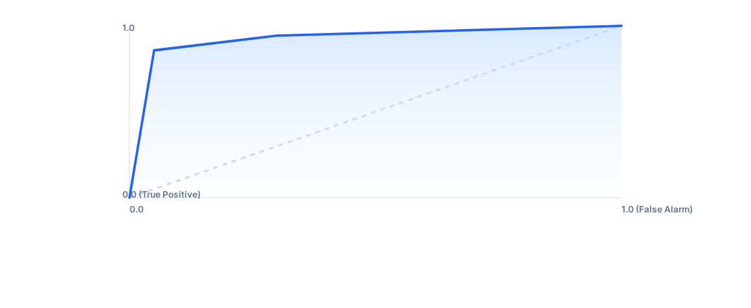
Grading on a Curve (ROC & AUC)
AUC (Area Under Curve): You want the blue line to shoot straight to the top left corner (High True Positives, Low False Alarms). An AUC score of 1.0 is an A+. 0.5 is an F (random guessing).
Instructor Notes:

Slide 24
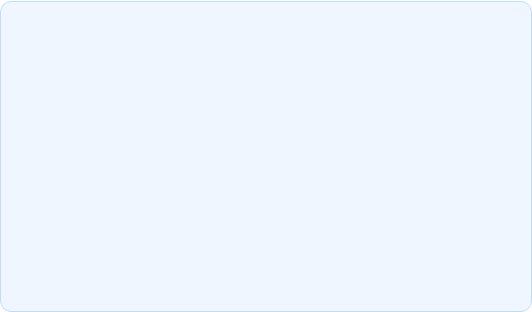
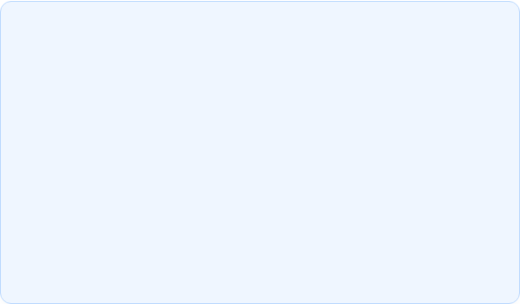


Predicting Numbers (Regression Metrics)
MAE (Mean Absolute Error)
RMSE (Root Mean Squared Error)
"On average, how far off are we?" If predicting house prices, an MAE of 10,000 means your predictions are generally off by $10,000 up or down.
"Punish the big mistakes!" Similar to MAE, but the math heavily penalizes the model if it makes a massive, wildly incorrect guess.
Instructor Notes:

Slide 25
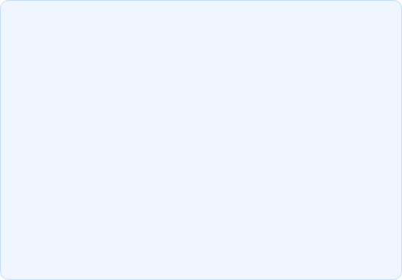
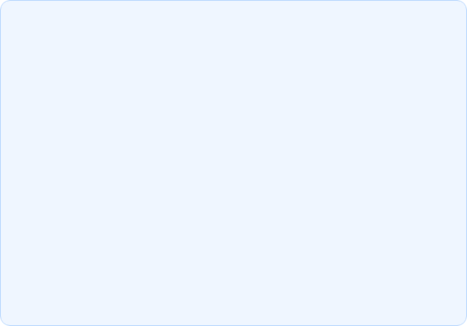
Scoring out of 100% (R² & Adjusted R²)
R-Squared (R²)
Adjusted R-Squared
Think of it as a score from 0 to 1 (or 0% to 100%).
The "Strict Teacher".
It acts just like R², but it mathematically subtracts points from your score if you add useless, garbage columns to your data.
An R² of 0.80 means your model can confidently explain 80% of why house prices go up and down. (The remaining 20% is random noise).
Rule: Always trust Adjusted R² more.
Flaw: If you give a model useless data, R² still goes up.
Instructor Notes:

Slide 26
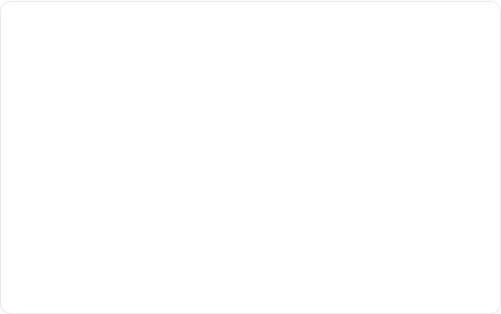
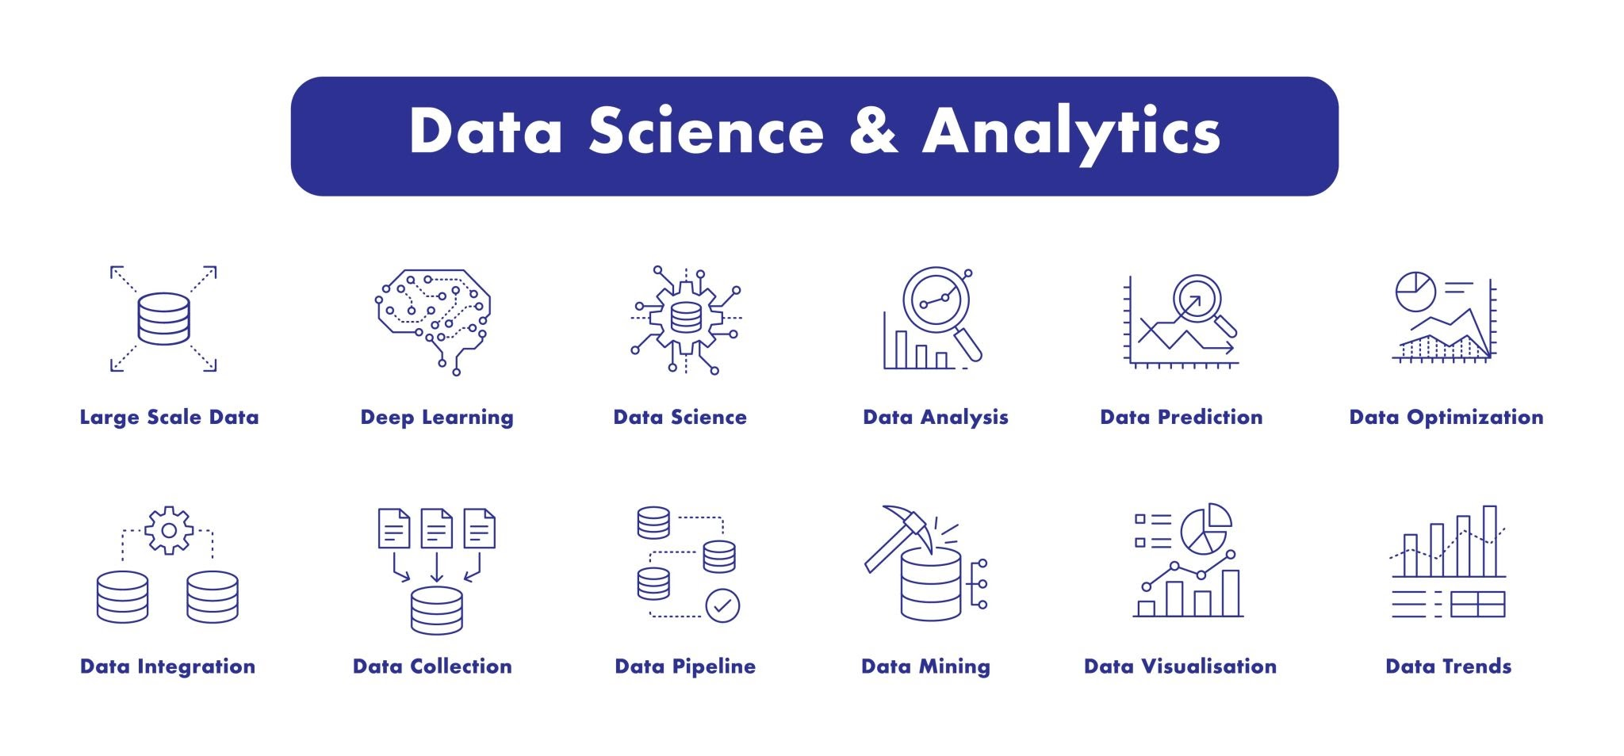
The Magic of ML Pipelines
•
The Concept: A pipeline acts like a factory assembly line. It links all your cleaning, encoding, and training steps into one single machine.
•
Why use them? 1. Beautiful, clean code. 2. Impossible to accidentally leak data. 3. You can feed raw data into one end, and predictions pop out the other automatically.
Instructor Notes:

Slide 27
Inside the Assembly Line
Station 2
Station 4
Encoder: Translates all text columns (like "Red") into numbers.
Model: The algorithm that actually learns and predicts!
Station 1
Station 3
Imputer: Automatically fills in any blank spots (NaN) in the data.
Scaler: Shrinks giant numbers so they match the small numbers.
Instructor Notes:

Slide 28
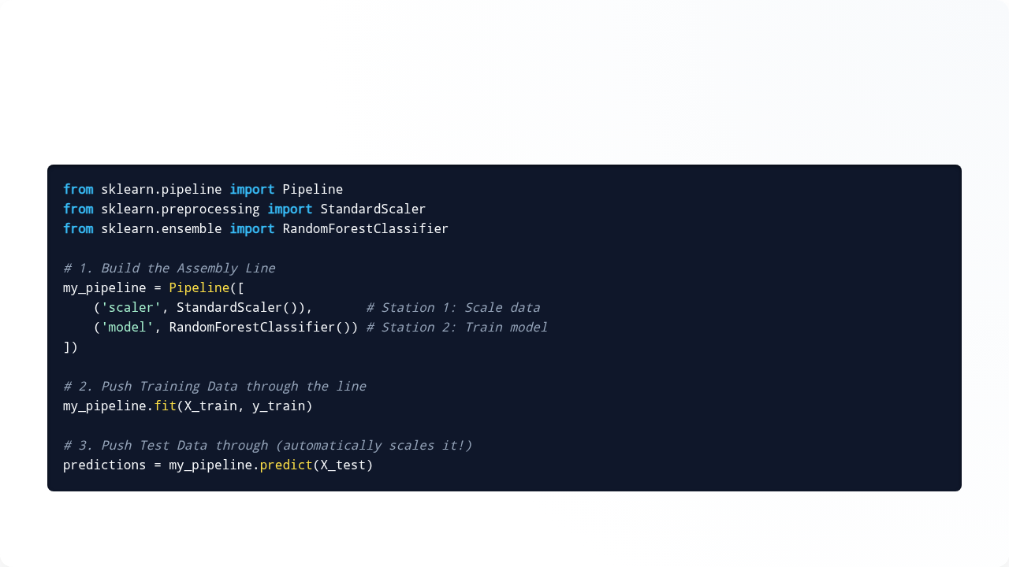
Pipelines in Python
Look how incredibly simple and clean the code becomes:
Instructor Notes:

Slide 29






Summary & Best Practices
The Golden Path
Don't Trip Up!
Pro Habits
Clean data → Feature Engineer → Split Data → Train Model → Evaluate.
Never test on Training Data. Don't trust Accuracy on skewed data. Always One-Hot Encode categories without rankings.
Always use Scikit-Learn Pipelines. Use Stratified Splits for classification problems.
Instructor Notes:

Slide 30
Questions?
Mini-Project Assignment:
Load the classic "Titanic Dataset". 1. Use One-Hot Encoding for Gender. 2. Build a Scikit-Learn Pipeline. 3. Train a Classifier to predict Survival. 4. Print out a Confusion Matrix to see where the model made mistakes!
Instructor Notes:

